Slide 1
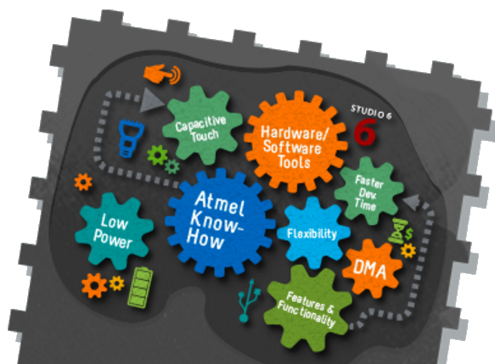
Edge Computing
Master’s on Applied Artificial Intelligence
1st Edition - 1st Semester

Slide 2
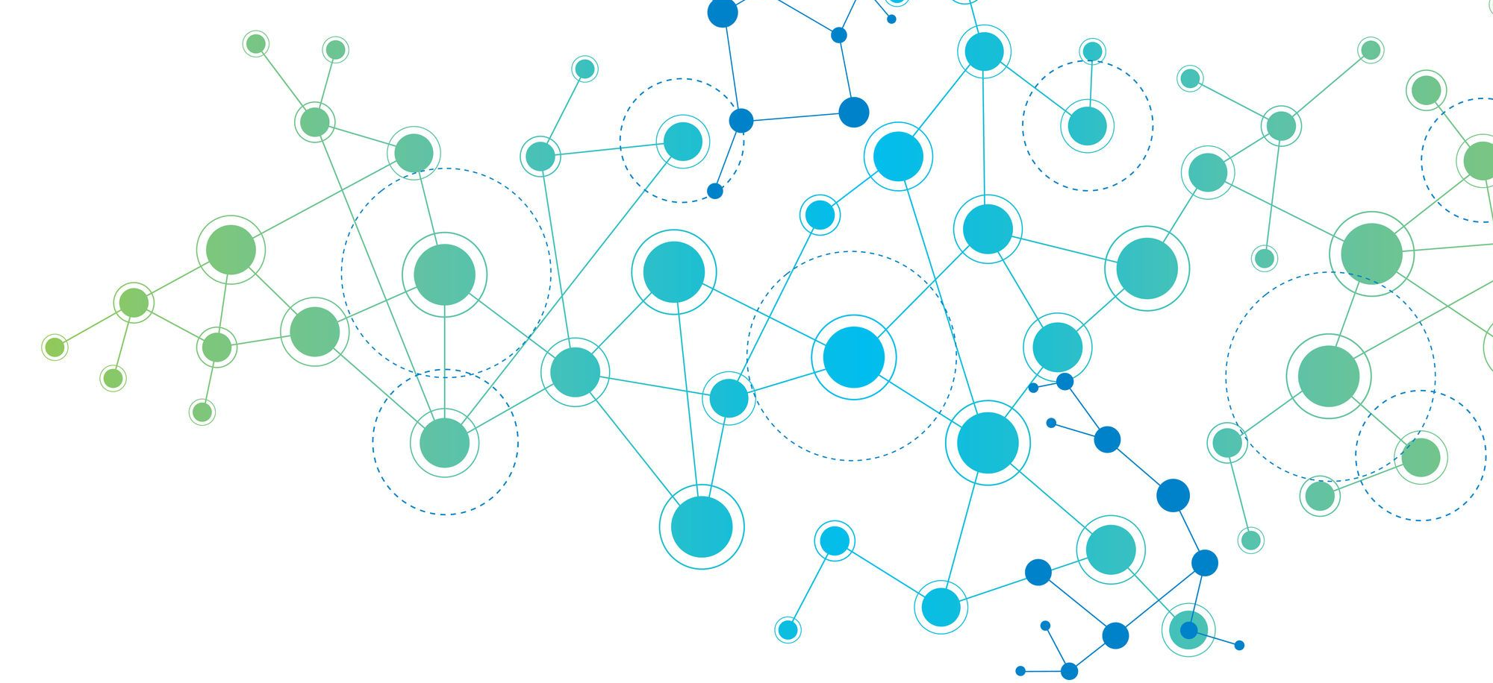
Summary
Embedded systems
IoT
AIoT
TinyML
Examples / Conclusion

Slide 3
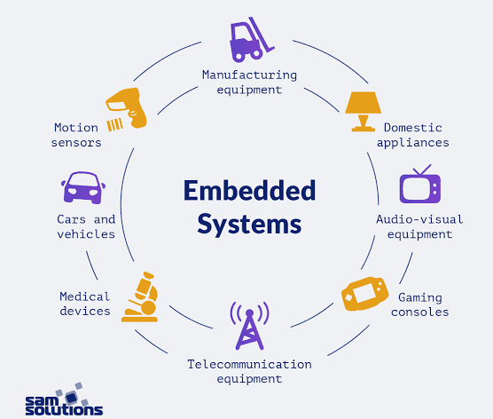
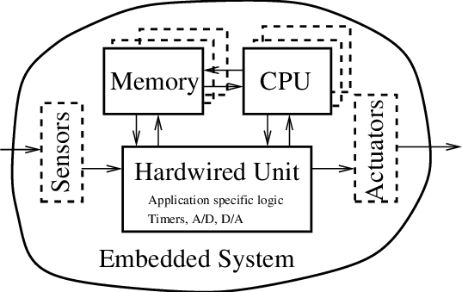
What is an embedded system?
An embedded system is a computing device that usually is small, or tiny, that operates with low power, extremely low power.
So much so that some of these devices can run for days, weeks, months, sometimes even years.

Slide 4
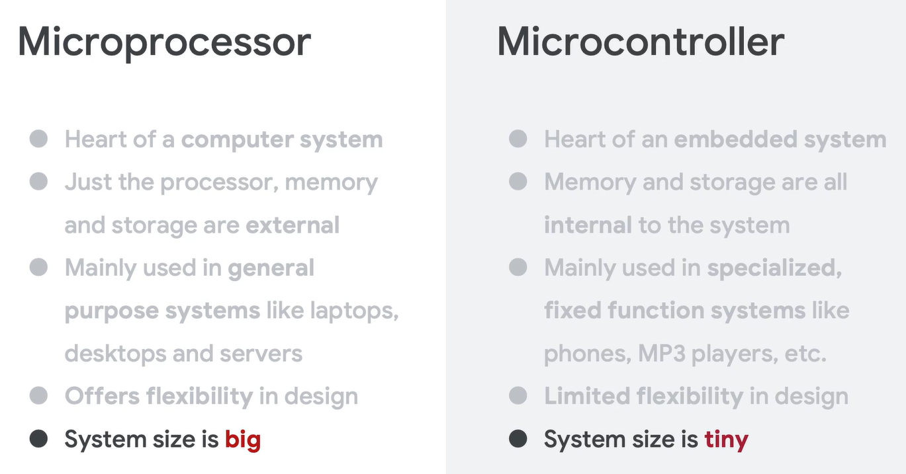
What is an embedded system?

Slide 5
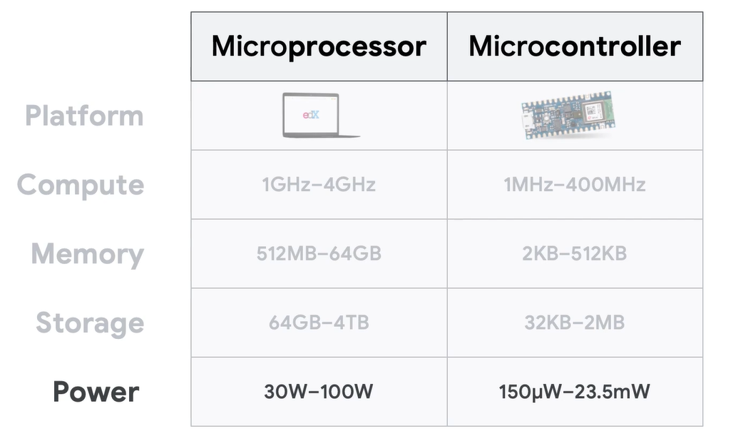
What is an embedded system?

Slide 6
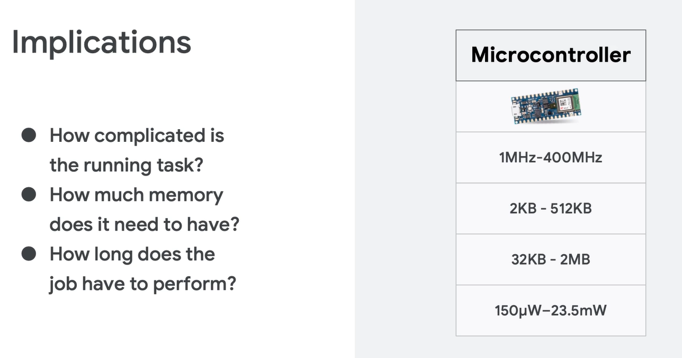
What is an embedded system?

Slide 7
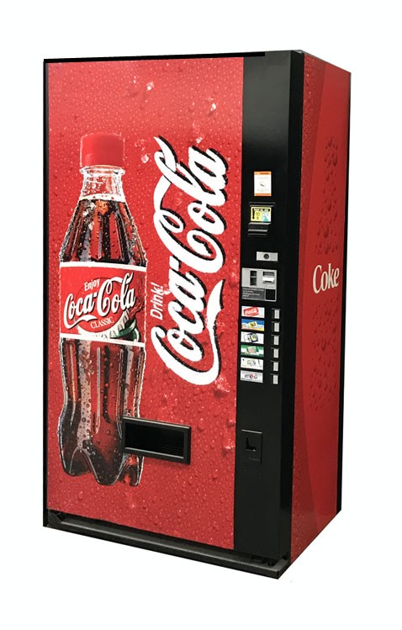
Internet of What ? Things…
It’s a new concept ?
Yes…
and no….
The first “Internet appliance" was a Coke machine at Pittsburgh's Carnegie Mellon University in 1982.
Programmers could check sensors to see how many drinks were present in the machine and if they were cold.
The Internet of Things (IoT) is a popular “buzzterm” describing the future of our evolving world.
Is also known as Machine to Machine Technology (M2M).

Slide 8
What’s Internet of Things ?
Why?
Kevin Ashton of MIT coined the phrase “Internet of Things" in 1999.
IoT represented “a vision in which the Internet extends into the real world embracing everyday objects. Physical item can be controlled remotely and can act as physical access points to Internet services.“
“We need to empower computers with their own means of gathering information, so they can see, hear and smell the world for themselves, in all its random glory.”

Slide 9
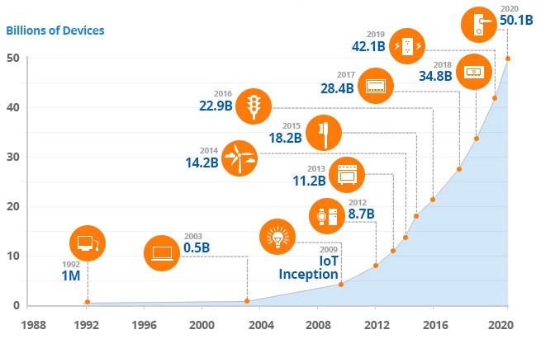
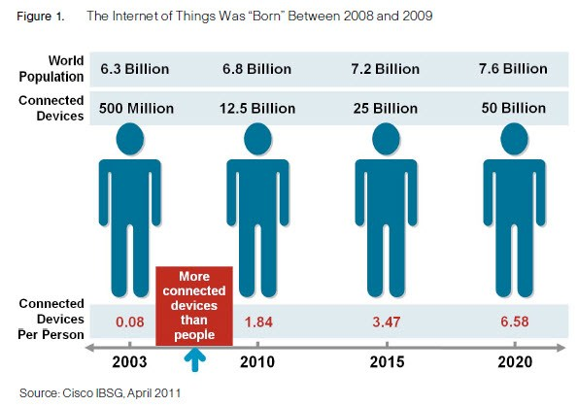
What’s Internet of Things ?
Current status?
data
bytes
bits

Slide 10
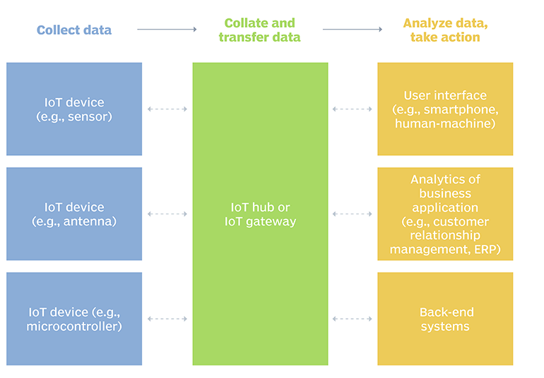
What’s Internet of Things ?
How it works ?
99.8% of time is useless information

Slide 11
The rise of the machines
Smart City
Parking, electric vehicles, green energy, safety
Real-time traffic control, road quality and noise
Optimize routes, JIT logistics
Improve digital awareness and interaction
Vital signs monitoring, real-time alerts, live pharmaceutics
Water and energy monitoring
Air quality
Food management, soil monitoring, fire
Traffic
Transportation
Education
Healthcare
Public Services
Environment
Agriculture

Slide 12
State of Art
IoT Architecture
Applications
Transportation
Environment
Assets
Energy
Health
Home
Retail
Industry
Security
Providers
AWS
Microsoft Azure
IBM
inFluxData
Particle
HiveMQ
Google Cloud
SAP
thingsBoard
mosquitto
MongoDB
Networks
Wifi
ZigBee
LoRA
NB-IoT/M
CoAP
OPC
AMQP
GSM/4G
Bluetooth
SigFox
MQTT
HTTP
webSocket
Hardware
Temperature
GPS
Microcontrollers
Cortex-M
RFID
Noise
Motion
Chemicals
FreeRTOS
Linux
Barcode

Slide 13







State of Art
Services
Visualization, control and security of every device in the Internet of Things (IoT) ecosystem is fundamental for long term success of any application.
Device Management
Authentication
Device Communication
SDK
Monitoring and registry
Data analytics
Cost

Slide 14






State of Art
Databases
The Internet of Things (IoT) generates vast amounts of data, including streaming data, real-time time series data, RFID data, sensor data, etc.
1) Size, scale and indexing
2) Handling a huge amount of data
3) User-friendly schema
4) Portability
5) Query languages
6) Process modelling and transactions
7) Heterogeneity and integration
8) Time series aggregation
9) Archiving
10) Security and cost

Slide 15


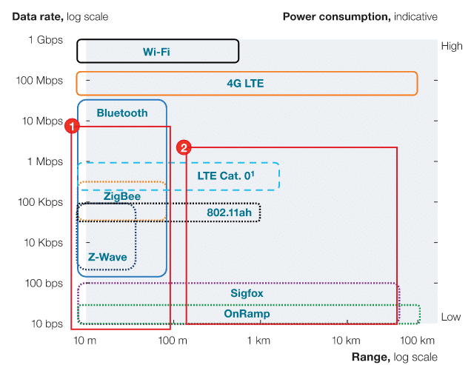



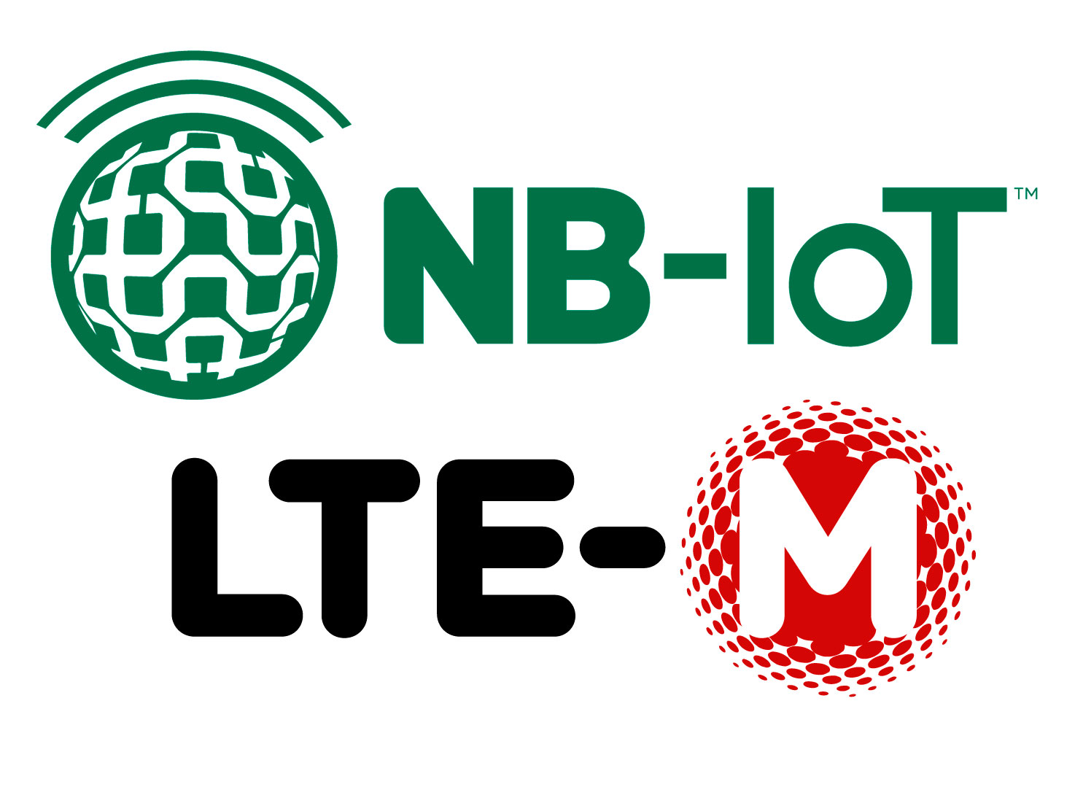

State of Art
Networks
The Internet of Things (IoT) is every were… even in remote locations or with constant environmental changes.

Slide 16


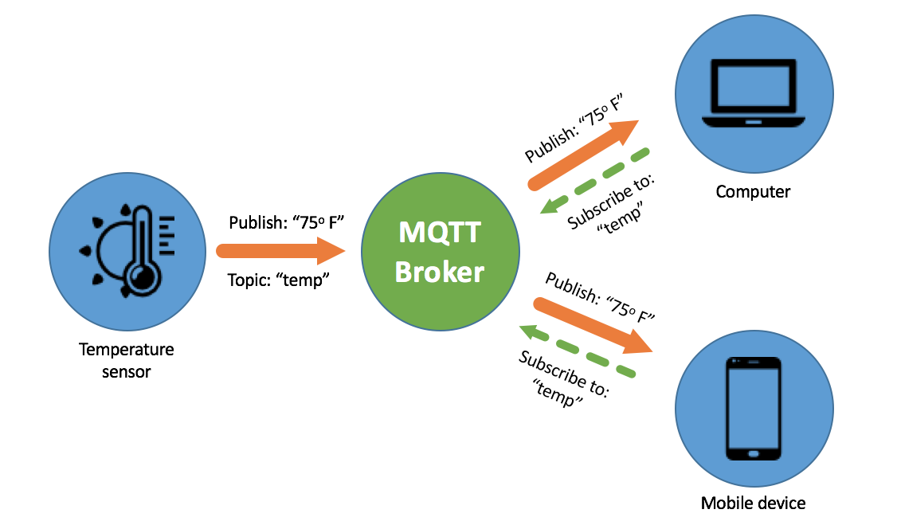


State of Art
Protocols
Internet of Things (IoT) devices generate data in a multiplicity of forms and speeds, from real-time to daily data, with or without compression. End devices have limited resources.
WebSocket

Slide 17


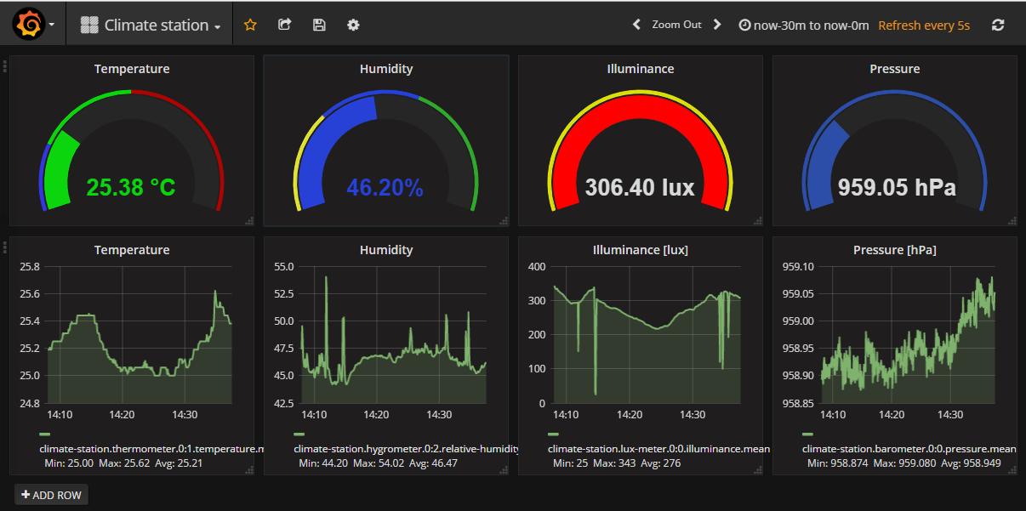
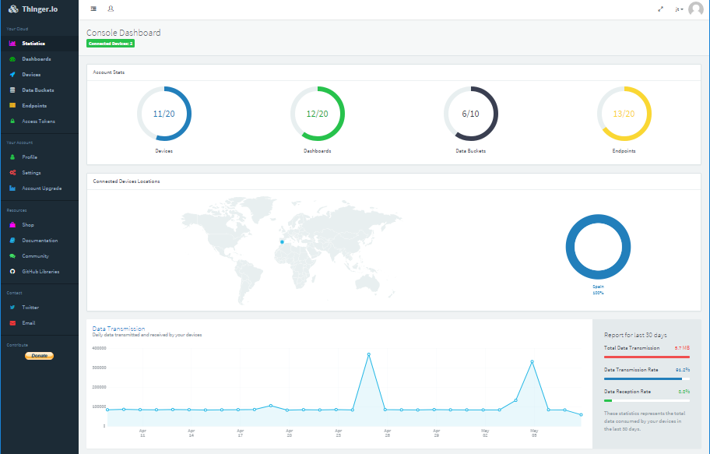

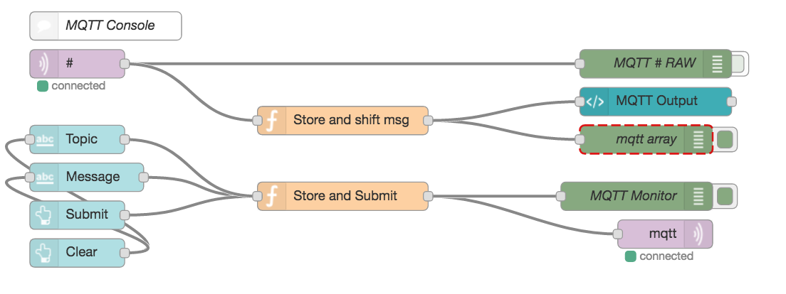



State of Art
Visualization
Visualization is essential for Internet of Things (IoT) to understand patterns or events in time-series. Human readable data.

Slide 18


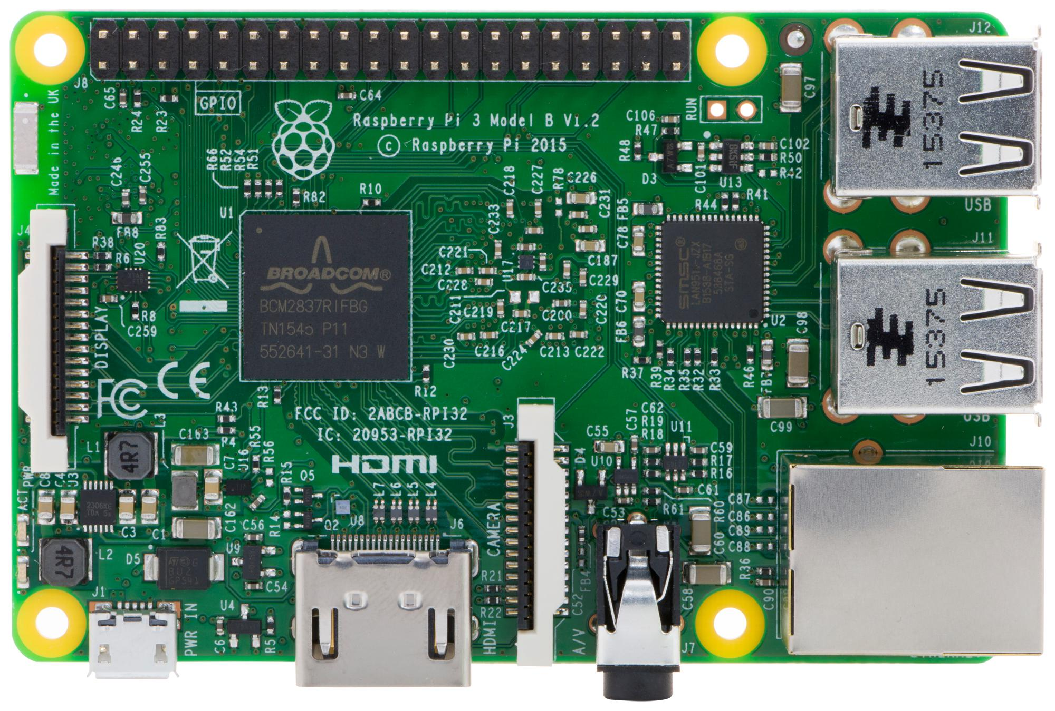
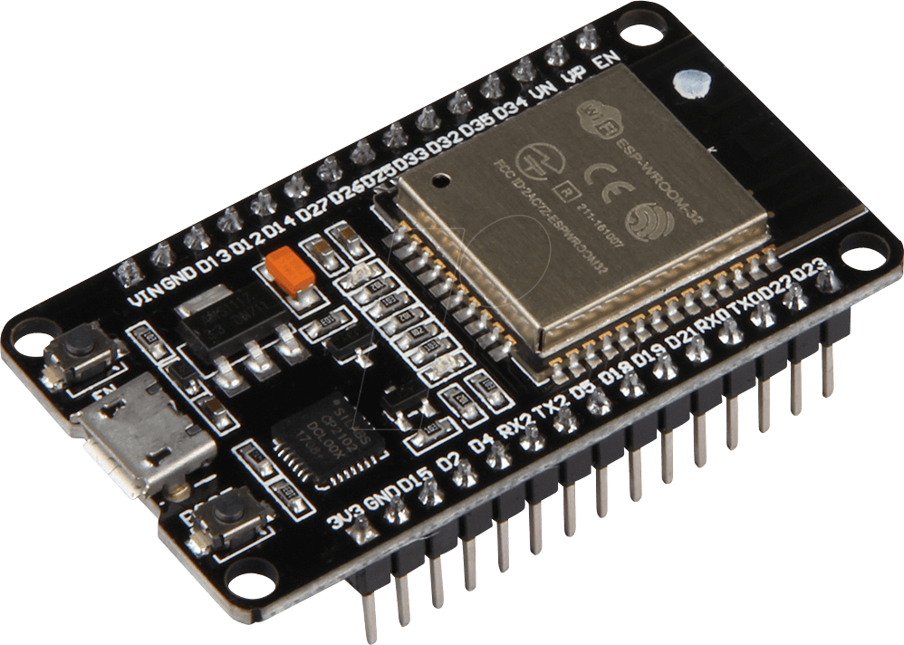




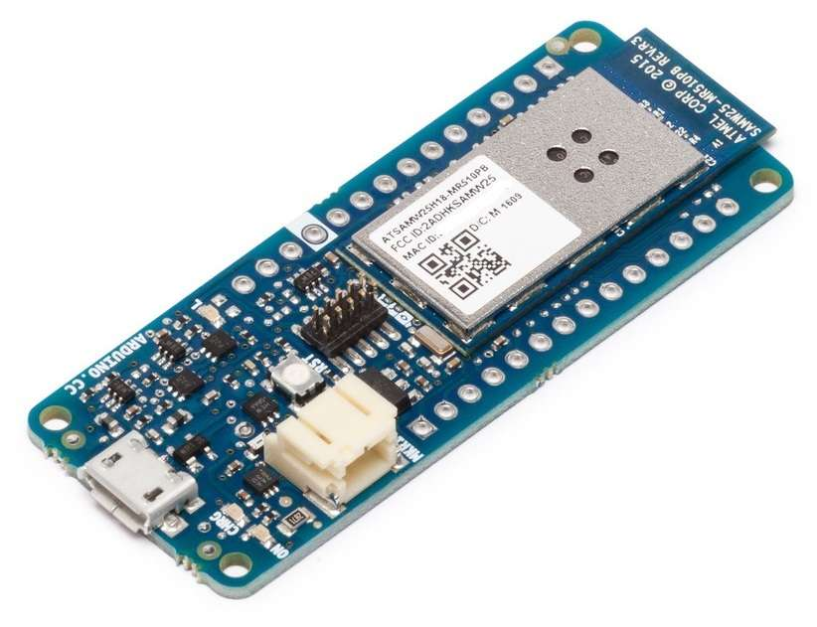
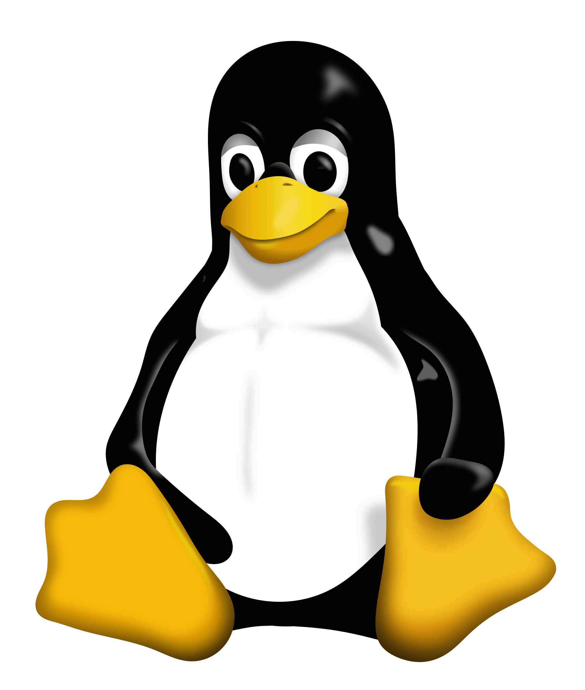
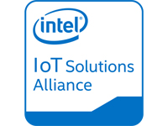



State of Art
Hardware
Internet of Things (IoT) is only possible because computational power has increased in end devices, allowing the implementation of high level protocols in low cost systems.

Slide 19

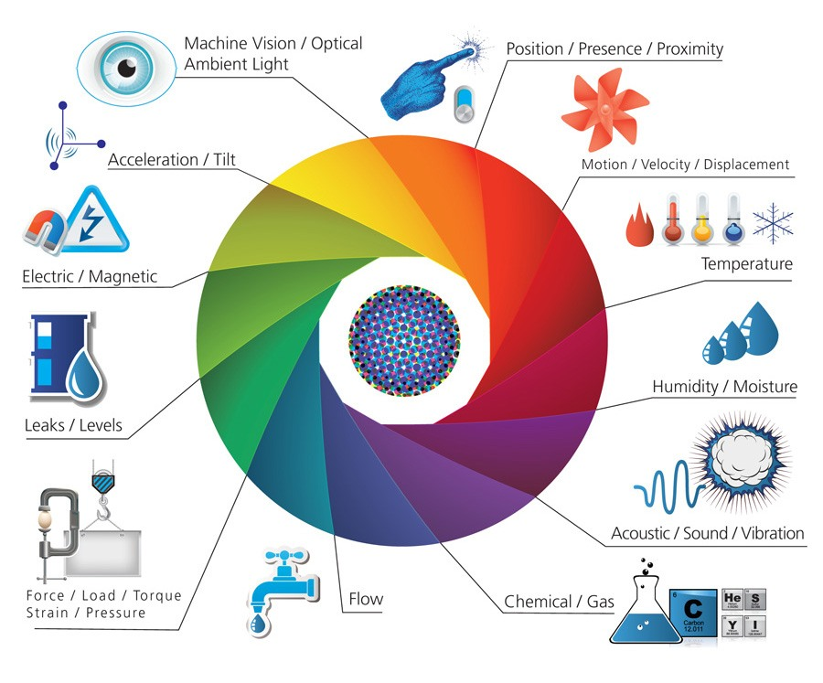


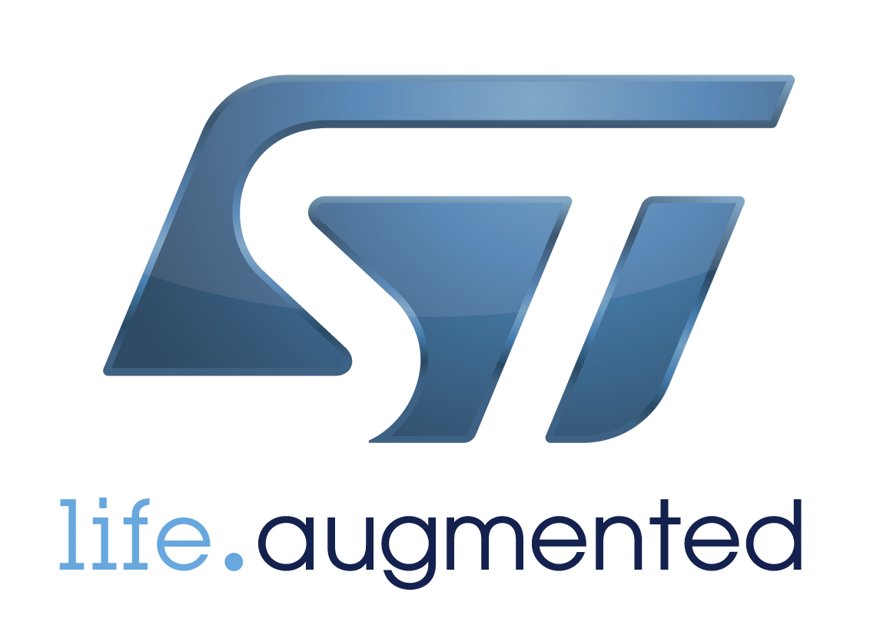





State of Art
Sensors
Sensors are essential for the rapid expansion of Internet of Things (IoT) through all business areas.

Slide 20
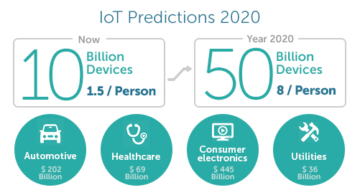
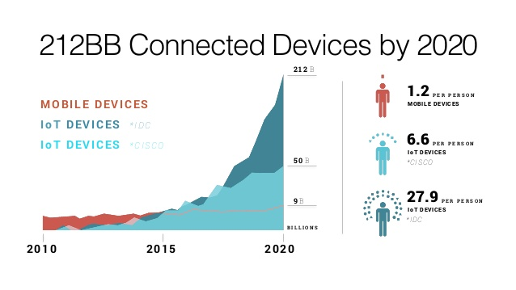

IoT Major challenges
Meeting customer expectations
Easing security concerns
Keeping IoT hardware updated
Overcoming connectivity issues
Governmental regulation

Slide 21
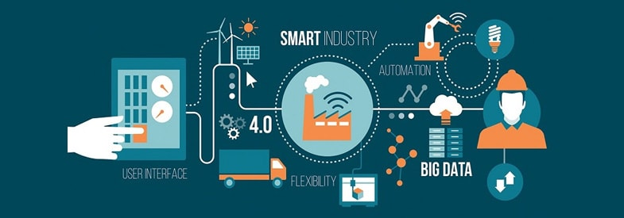
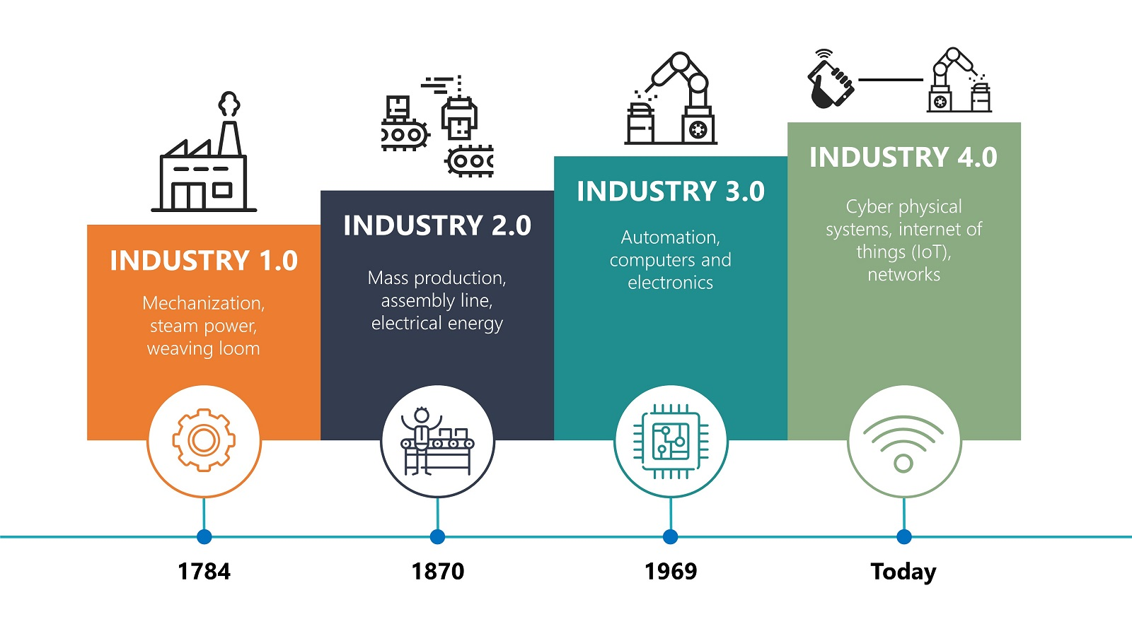
Future of IoT
IIot
Industrial IoT (IIoT) and Industry 4.0
Improve efficiency
Reduce waste
Reduce downtime
Predictive maintenance
Flexible production
ERP + IIoT
Digital Twins

Slide 22


Imagining Industry 5.0

Slide 23
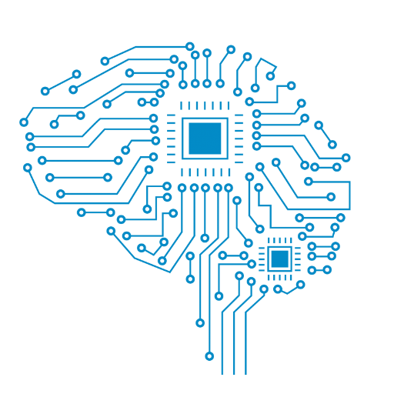

Imagining Industry 5.0
ARTIFICIAL INTELLIGENCE
AI delivers the promise of rapid processing of large amounts of data and deep machine learning, the applications in manufacturing are endless with Industry 5.0.
MANUFACTURING IN THE AUGMENTED AGE
In the augmented age of Industry 5.0, we will use tools like VR headsets to augment our skills and to make processes simpler and more repeatable.
Is expected to be using AR glasses to deliver a mixed reality experience to both our staff and our visitors.

Slide 24


Imagining Industry 5.0
COBOTS – COMPANIONS AND COLLABORATORS
The most important part of the application of robotics with Industry 5.0, like other forms of automation is going to be the human machine interface (HMI) and the close and mutually beneficial relationship between the two.
Robots will learn from humans, as well as sharing their ability to do the tasks operators can’t, or don’t need to do.
WEARABLES THAT KEEP OUR TEAM SAFE
Wearables like smart gloves offer the user the ability to use gesture control to operate equipment as well as pull up display information or make adjustments; but what about smart fabrics that monitor stress levels within operators doing challenging and mission critical work?

Slide 25
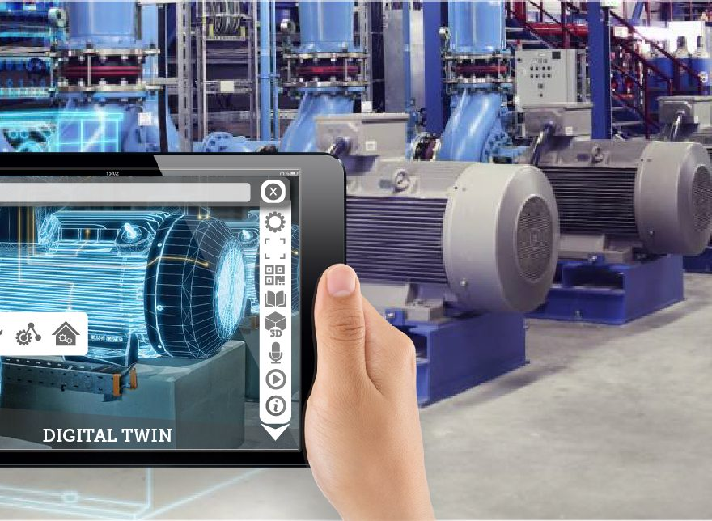
Imagining Industry 5.0
DIGITAL TWIN
Powered through intelligent machine-to-machine (M2M) communication and Track Trace and Control (TTC) System, think our factory is a shining example of the Internet of Manufacturing (IoM) for an EMS provider.

Slide 26


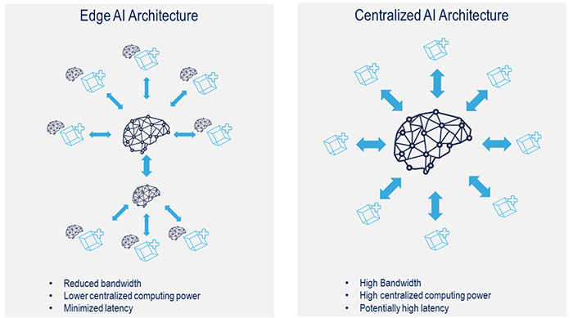
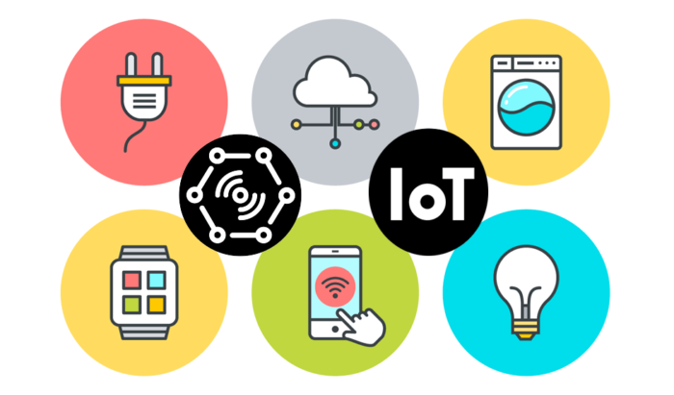
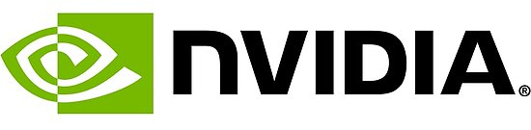
Future of IoT
AIoT
IoT (IIoT) and Artificial intelligence
Cloud dependent
Ai ethics and safety

Slide 27
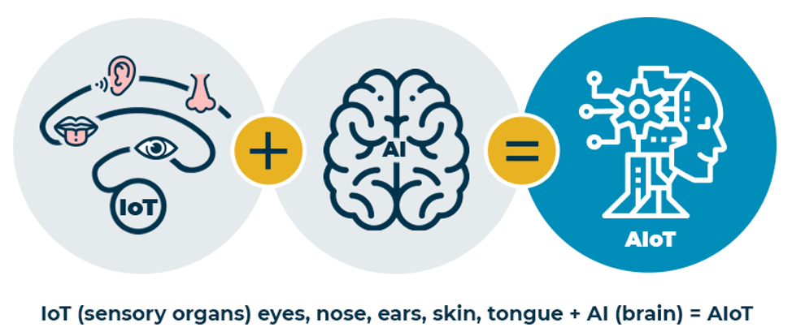
AIoT When Ai/ML Meets the Internet of Things

Slide 28
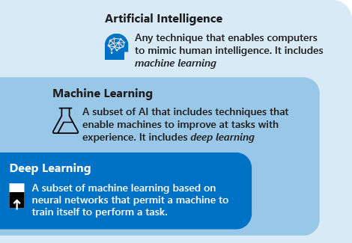
AIoT What is Machine Learning?
Machine learning is a subfield within AI, or artificial intelligence, that uses a lot of data to infer interesting patterns about new data that it's seeing.
Image Recognition
Speech Recognition
Medical diagnosis
Statistical Arbitrage
Learning associations
Classification
Prediction
Extraction
Regression
Financial Services

Slide 29
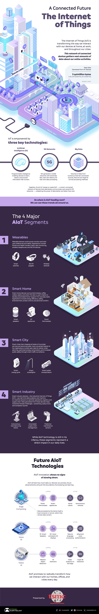
AIoT When Ai/ML Meets the Internet of Things
IoT devices use the internet to communicate, collect, and exchange information about our online activities.
AIoT is at the tipping pointing of the automation revolution.

Slide 30
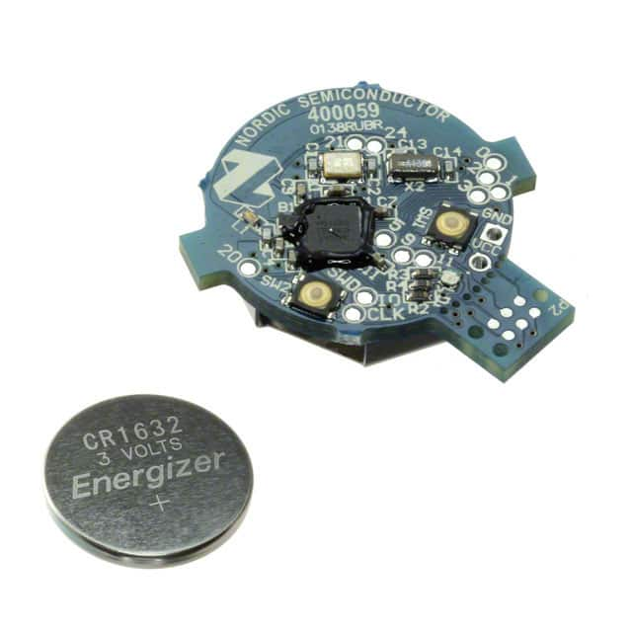
and then… TinyML
Tiny machine learning, is a fast-growing field of machine learning technologies and applications that include algorithms, hardware, and software that can perform on-device sensor data analytics, doing so at extremely low power, typically in the order of milliwatts, so that we can enable always-on machine learning use cases on battery-powered devices.

Slide 31
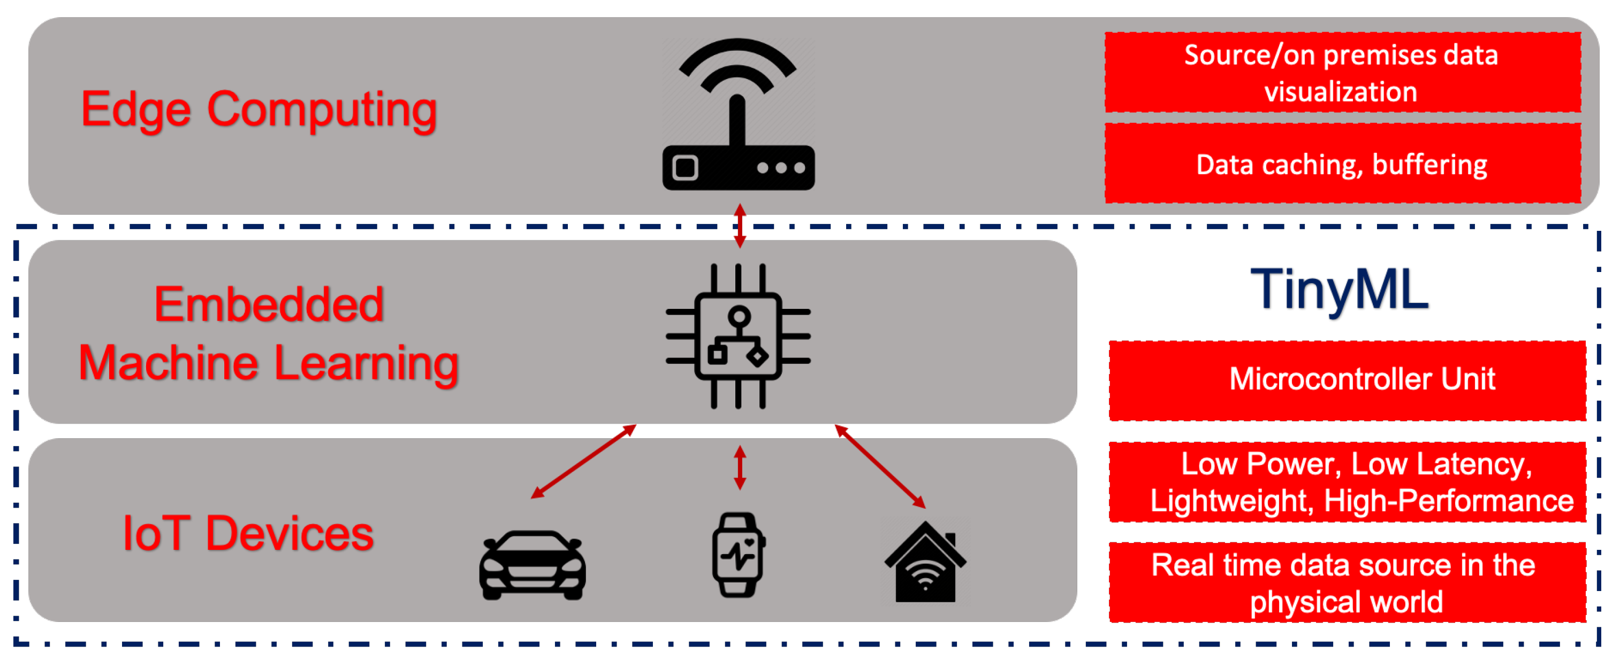
and then… TinyML
Tiny machine learning, is a fast-growing field of machine learning technologies and applications that include algorithms, hardware, and software that can perform on-device sensor data analytics, doing so at extremely low power, typically in the order of milliwatts, so that we can enable always-on machine learning use cases on battery-powered devices.

Slide 32
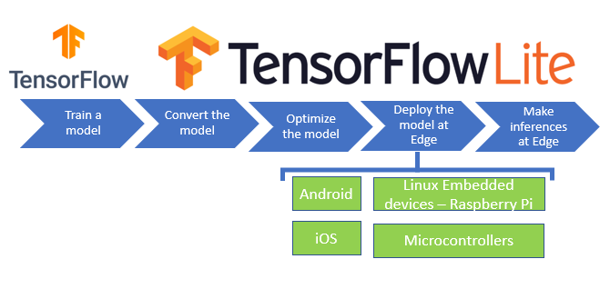
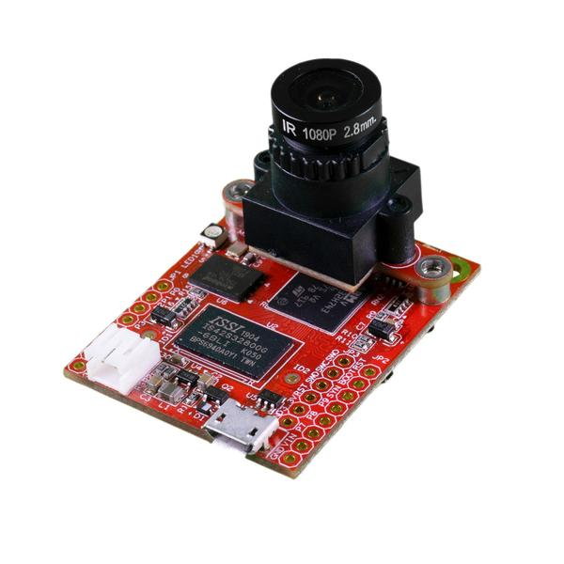


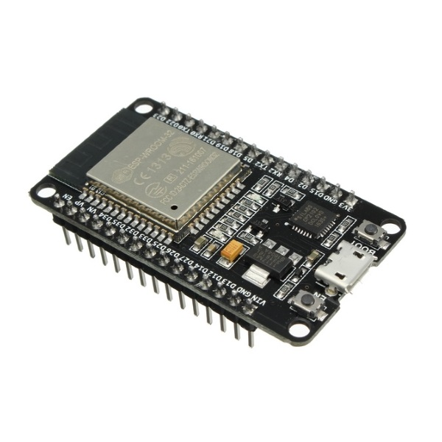


TinyML How it works
TinyML algorithms work in much the same way as traditional machine learning models.

Slide 33
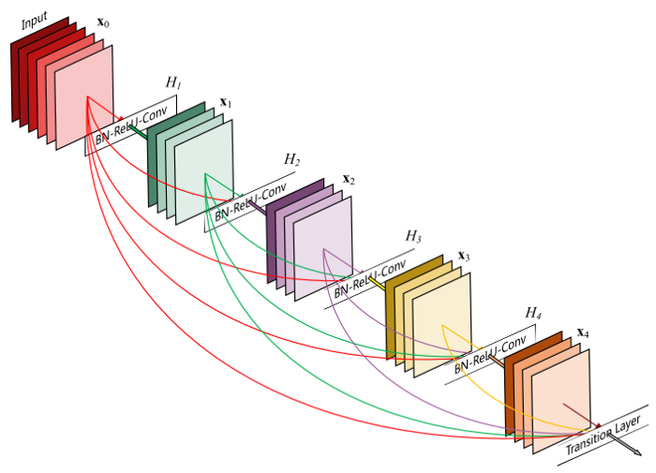
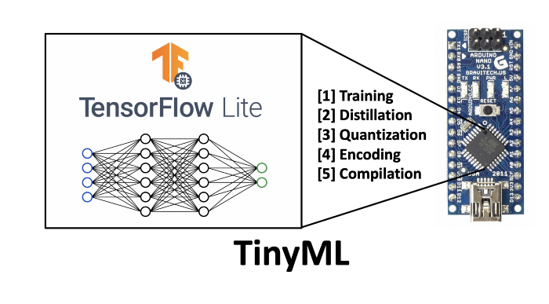
TinyML How it works
TinyML algorithms work in much the same way as traditional machine learning models.
1. Focus... Focus... Focus…
2. Optimize…
Optimize…
Optimize…
Large & complex networks (up to GB size)

Slide 34
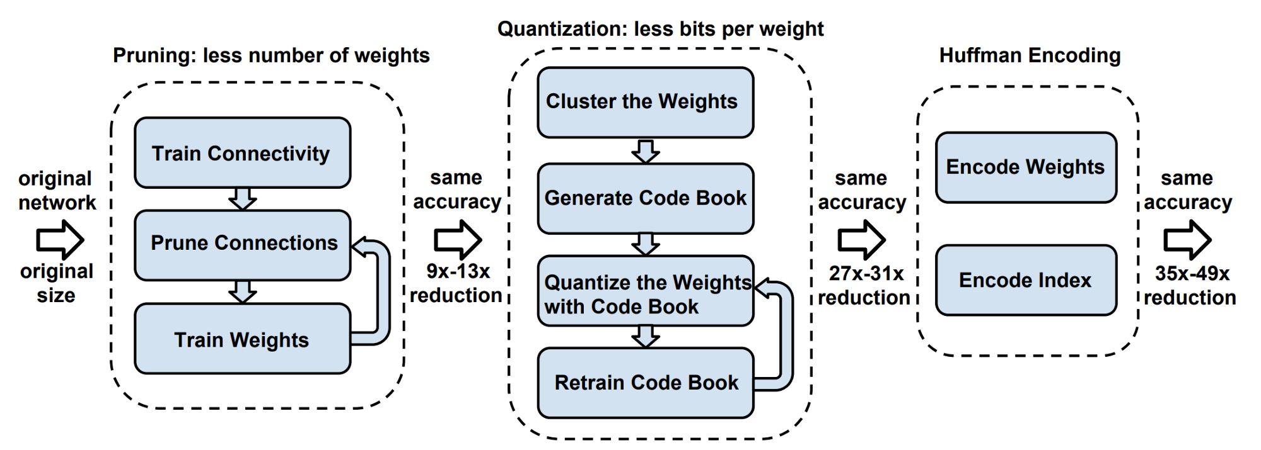
TinyML How it works
TinyML algorithms work in much the same way as traditional machine learning models.

Slide 35
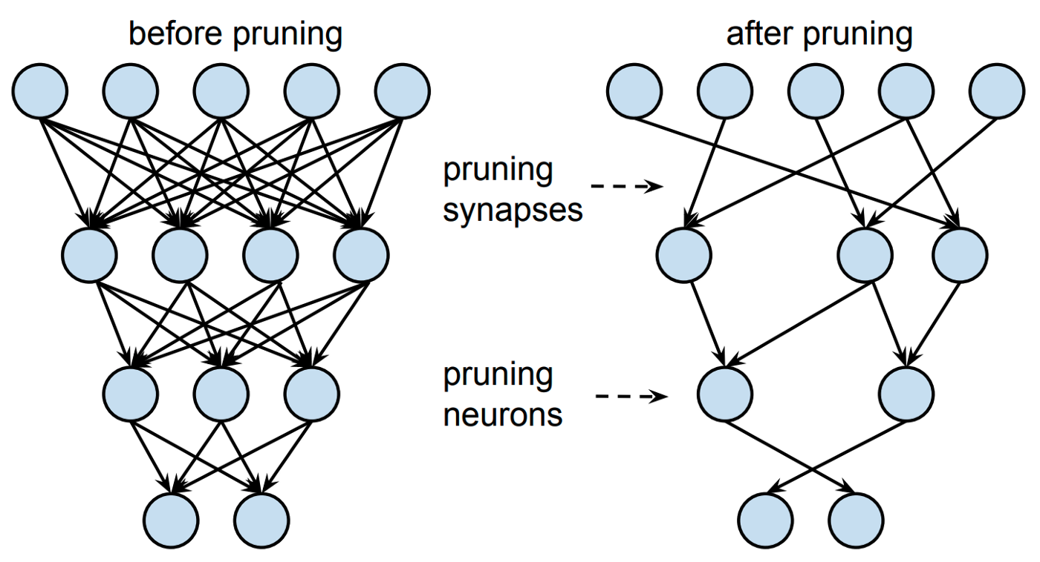
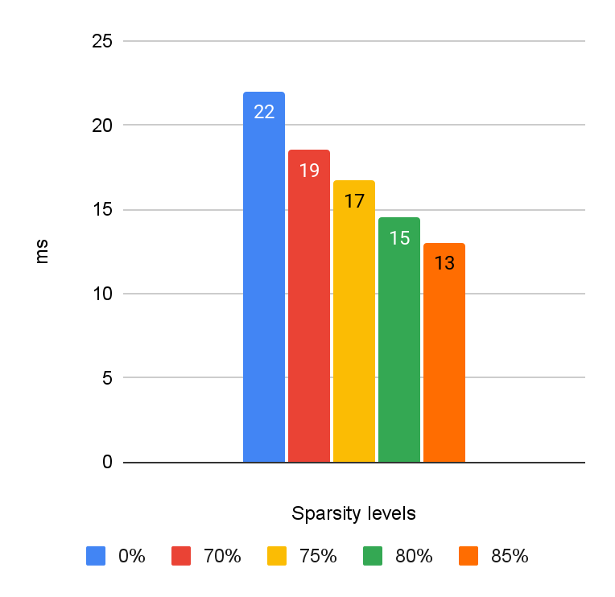
TinyML How it works
TinyML algorithms work in much the same way as traditional machine learning models.

Slide 36
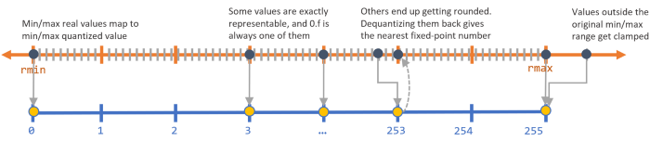
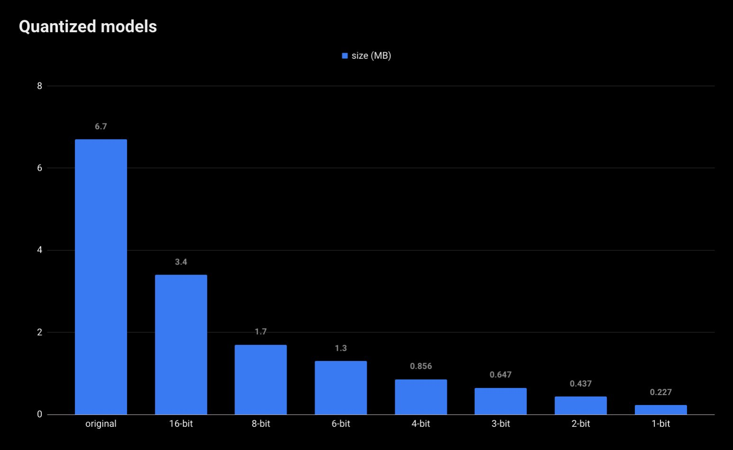
TinyML How it works
TinyML algorithms work in much the same way as traditional machine learning models.
Quantization

Slide 37
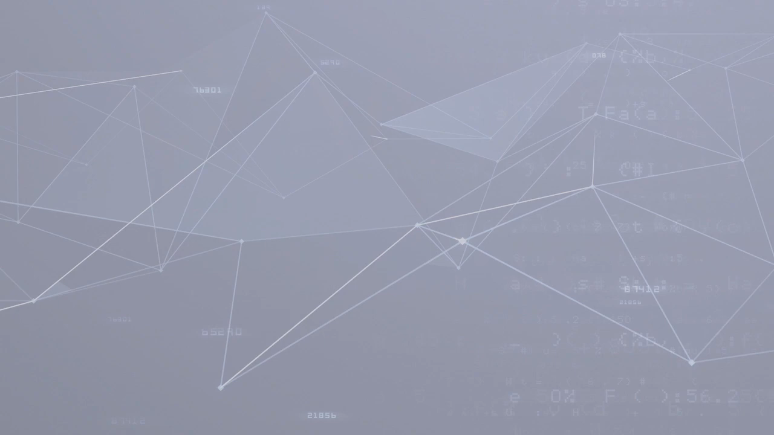
TinyML Examples

Slide 38

TinyML Examples

Slide 39
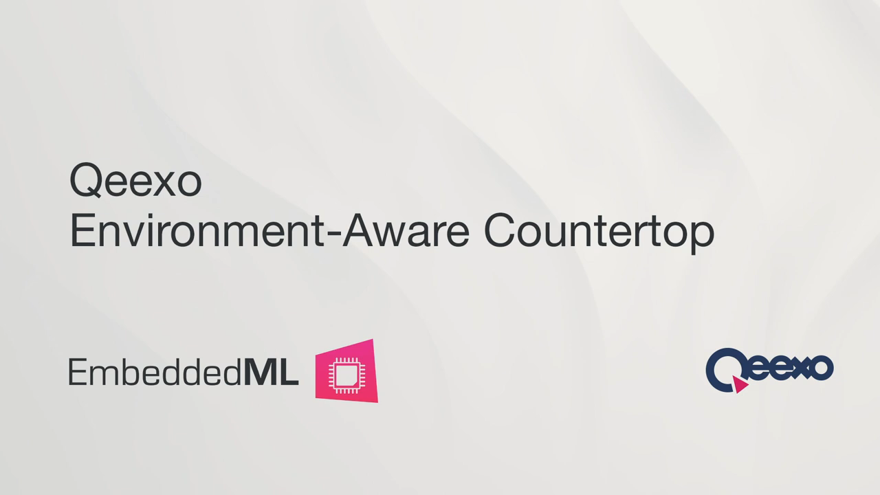
TinyML Examples

Slide 40
Conclusion
The Next AI Revolution
Allows IoT to grow continuously with limited impact in the worldwide data transition capabilities.
The ability to run machine learning models on resource-constrained devices opens opportunities to many new applications.
New efficient intelligence based on data-driven algorithms

